Slide 1

Major Project Presentation-I B.E. (Computer) Sem - VIII
Lokmanya Tilak College of Engineering, Navi Mumbai
Computer Engineering
2024-25

Slide 2

Solving the class imbalance problem using a Counterfactual method for Data Augmentation
Group members:
Abhijay Singh 215
Abhishek Tiwari 216
Aniket Gupta 221
Hanzala Sarguroh 228
Name of Project Guide:
Prof. Kahkashan Siddavatam

Slide 3
Presentation Outline
• Abstract
• Introduction
• Literature Survey
• Limitations of Existing system
• Problem Statement and Objectives
• Scope
• Proposed System
• Analysis / Framework / Algorithm
• Details of Hardware and Software
• Methodology
• Implementation Plan for next Semester
• Conclusion
• References

Slide 4
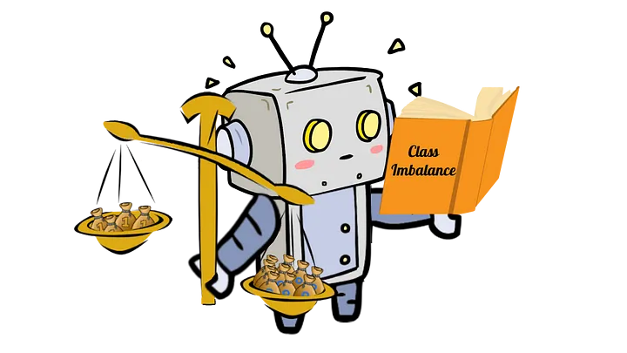
ABSTRACT
Machine learning models often struggle to perform well on datasets where one class is significantly more prevalent than others. This common scenario, known as class imbalance, poses a significant challenge.
In such cases, the majority class dominates the data, which can cause models to focus disproportionately on this class during training.
As a result, models tend to overfit to the majority class, leading to poor performance on the minority class.
This imbalance can severely impact the model's ability to correctly identify minority class instances, such as detecting fraudulent transactions or diagnosing rare medical conditions.

Slide 5
INTRODUCTION
Our project addresses the challenge of class imbalance in machine learning, where one class significantly outnumbers another. This imbalance often results in models that perform well on the majority class but struggle with the minority class, leading to biased outcomes. Our goal is to develop a method that improves how models handle imbalanced datasets, ensuring better overall accuracy and performance.
Project Focus:
Create Counterfactual Augmentation (CFA): A method to generate realistic synthetic data for the minority class.
Enhance Model Accuracy: Improve the model’s ability to correctly classify the minority class.
Apply Across Domains: Focus on general applications where class imbalance impacts model performance.
Test and Validate: Conduct experiments to confirm the effectiveness of the method across various datasets and models.

Slide 6
LITERATURE SURVEY
Sr. No | Authors | Title of the paper & year of publish | Major contributions/ Methods Used | Gaps
1 | Johnson & Khoshgoftaar | Survey on Class Imbalance Learning (2019) | Comprehensive review of existing methods (sampling, cost-sensitive, ensemble) | Lack of new method proposals; focuses on existing methods without offering novel approaches.
2 | M Buda, A Maki, MA Mazurowski | A Systematic Study of the Class Imbalance Problem in Convolutional Neural Networks(2018) | Class weighting, resampling methods | Focused primarily on image data and CNNs; limited generalizability to other data types and algorithms.
3 | Mohammed Temraz Mark T. Keane | Solving the Class Imbalance Problem Using a Counterfactual Method for Data Augmentation (2024) | Counterfactual data augmentation to create balanced datasets | Relatively new; lacks large-scale validation across diverse datasets and domains.

Slide 7
LIMITATIONS OF EXISTING SYSTEM
Oversampling and Undersampling Methods:
Can lead to overfitting by duplicating or generating synthetic data without adding meaningful diversity.
Undersampling may remove important info. from the majority class, reducing model accuracy.
Synthetic Minority Over-sampling Technique (SMOTE):
Generates synthetic samples by interpolation, which may not capture complex data distributions.
Can introduce noise and unrealistic samples, negatively affecting model performance.
Cost-Sensitive Learning Approaches:
Heavily dependent on the choice of cost matrix, which can be subjective and difficult to optimize.
Not suitable for all types of imbalanced data, particularly in multi-class scenarios.
Ensemble Methods (e.g., Boosting, Bagging):
High computational cost due to multiple models training.
Limited effectiveness when dealing with severe class imbalance.
Generative Adversarial Networks (GANs):
Computationally expensive and resource-intensive.
Unstable training process; may produce unrealistic or biased samples.

Slide 8
PROBLEM STATEMENT & OBJECTIVES
Problem Statement:
Class imbalance in datasets often leads to poor model performance due to the underrepresentation of minority classes. Traditional augmentation methods may introduce noise or fail to capture subtle changes needed for better minority class detection. There is a need for precise augmentation techniques that enhance minority class representation while minimizing noise.
Objectives:
Develop a Counterfactual Augmentation (CFA) Method: Create a CFA method that uses real-world counterfactual instances to generate synthetic data, aiming for better accuracy and relevance than existing techniques.
Empirical Validation: Test the CFA method on various datasets to evaluate its effectiveness in addressing class imbalance and producing high-quality synthetic data.
Enhance Model Performance: Demonstrate how CFA improves model performance on imbalanced datasets by providing a more accurate representation of the minority class and reducing model bias.

Slide 9
SCOPE
Detailed Methodology of CFA: Describe the step-by-step process of how the CFA method generates synthetic data using real-world counterfactual instances.
Comparison with Traditional Methods: Compare CFA with existing techniques like SMOTE, highlighting the advantages of CFA in reducing noise and enhancing minority class representation.
Performance Metrics and Analysis: Showcase the evaluation metrics used (e.g., Precision, Recall, F1 Score) and analyze the effectiveness of CFA in improving these metrics compared to other methods.
Challenges and Limitations: Discuss any challenges faced during the implementation of CFA and its current limitations, providing a balanced view of the method’s effectiveness.

Slide 10
PROPOSED SYSTEM
Counterfactual Augmentation (CFA)
What is CFA?
CFA is a technique used to solve class imbalance in machine learning datasets by generating synthetic data instances in the minority class by using instances from the majority class.
How? (Pima Indians Diabetes Dataset)
Find an unpaired instance from the majority class.
Example: A non-diabetic patient with Glucose Level: 140
Find the nearest neighbor counterfactual pair (using Explainable AI).
Example: Pair → (Glucose: 135 - Majority, Glucose: 120 - Minority)
Difference = 135 - 120 = 15
Apply the difference to the unpaired instance.
New synthetic instance: Glucose Level: 125 (now classified as diabetic)
New instance of the Minority Class is created.
Confirmation (does created new instance actually belongs to minority class?)
Model Confirmation is done through the inherent design of the Counterfactual Augmentation (CFA) method, which uses the decision boundary defined by the machine learning model to ensure that the synthetic data points generated are correctly classified into the minority class.

Slide 11
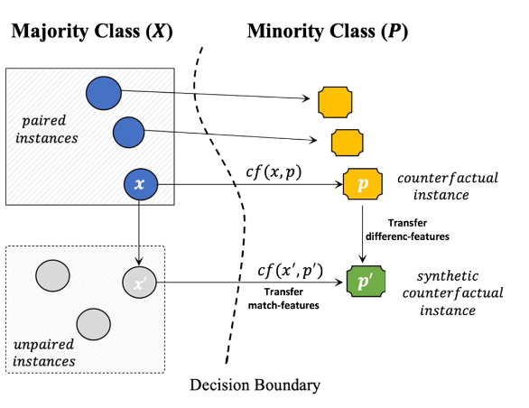
PROPOSED SYSTEM
Counterfactual Augmentation (CFA)
Decision Boundary: line /curve/surface that separates region associated with different classes.
The classifiers (algorithms) like Random Forest (RF), k-Nearest Neighbors (k-NN) and Logistic Regression (LR) create decision boundaries based on the patterns they learn from the training data. These decision boundaries are used to judge or classify the synthetic data generated by the (CFA) method
Advantages:
Utilizes Both Majority and Minority Class Information.
Reduced Risk of Noise and Overfitting due to minimal features changes
Realistic and Plausible Data Generation.

Slide 12
ALGORITHM
Train Model on Imbalanced Data:
Begin by training a classification model using the original imbalanced dataset.
Evaluate the model’s performance, focusing on metrics like precision, recall, and F1-score to emphasize the imbalance’s effect on class predictions, particularly for the minority class.
Apply SHAP & LIME for Feature Importance:
Utilize SHAP and LIME to explain the model’s predictions.
Identify the key features that influence the majority and minority class outcomes.
This step helps to understand how the class imbalance skews feature importance.
Counterfactual Data Generation:
Implement a counterfactual approach to generate synthetic data for the minority class.
Focus on producing data points near the decision boundary, helping the model better distinguish the minority class from the majority class.
Retrain Model with Augmented Data:
Retrain the classification model using the newly balanced dataset, which includes both the original and generated synthetic data.
Re-evaluate the model’s performance and apply SHAP & LIME once more to observe how feature importance shifts with the augmented dataset.
This final step assesses improvements in handling the minority class.

Slide 13
DETAILS OF HARDWARE AND SOFTWARE
Hardware Details:
Laptop: MacBook Pro 2015
Processor: 2.9 GHz dual-core Intel Core i5
Memory: 8 GB 1867 MHz DDR3 RAM
Storage: 256 GB SSD
Operating System: macOS Monterey
Software Details:
Development Environment: Google Colab (cloud-based platform for machine learning and data science)
Programming Language: Python (used for implementation)
Libraries/Frameworks:
scikit-learn: For machine learning tasks and dataset manipulation
imbalanced-learn: For handling class imbalance in datasets
SHAP: For explainability (if used in conjunction with counterfactual methods)
NumPy, Pandas: For data handling and processing
Matplotlib, Seaborn: For data visualization
Version Control: Git (for project versioning and collaboration)
Storage: Google Drive (for saving and accessing large datasets)

Slide 14
METHODOLOGY
Dataset Analysis (Pre-Augmentation):
Load the imbalanced dataset.
Train an initial model on the original data.
Apply SHAP and LIME to understand feature importance and identify which features are most influential in determining class outcomes.
Observe how the class imbalance affects model predictions (e.g., focus on the majority class).
Data Augmentation Using Counterfactuals:
Use a Counterfactual Method to generate new synthetic examples for the minority class.
Ensure augmented data is realistic and reflects the patterns identified during the SHAP/LIME analysis.
Model Training (Post-Augmentation):
Retrain the model on the balanced dataset created through augmentation.
Reapply SHAP and LIME:
Analyze feature importance post-augmentation.
Compare changes in feature significance and prediction behavior after the augmentation.
Comparison and Evaluation:
Compare model performance metrics (precision, recall, F1-score, etc.) before and after augmentation.
Evaluate shifts in SHAP/LIME results, especially in relation to the minority class.

Slide 15
IMPLEMENTATION PLAN FOR NEXT SEMESTER
Objective: Improve the existing counterfactual data augmentation method by generating more representative minority class samples.
Step 1: Initial Data Generation
Generate minority class data from majority class samples, similar to the existing method.
Focus on creating synthetic samples that reflect the minority class characteristics.
Step 2: Comparison with Actual Minority Data
Compare the newly generated data with actual minority class data to assess similarities and differences.
Step 3: Adjustment of Synthetic Data
Modify the newly generated data to better align with the distribution of the minority class.
Ensure that the synthetic data lies within the core minority class distribution rather than just at the decision boundary.
Expected Outcome:
More realistic and well-distributed minority class samples.
Improved model performance by reducing overfitting on borderline cases.
Enhanced generalization across the entire minority class feature space.

Slide 16
CONCLUSION
Successful Implementation of Counterfactual Data Augmentation:
Developed and implemented a counterfactual method to address class imbalance, generating synthetic minority class samples that enhance model training.
Insights from Explainable AI (XAI):
Applied SHAP and LIME to analyze feature importance, leading to a deeper understanding of the model’s decision-making process.
Identified key features influencing class predictions, particularly for the minority class.
Enhanced Model Performance:
Retrained the model on the balanced dataset, resulting in improved performance metrics and a better ability to classify minority class instances.
Observed significant shifts in feature importance post-augmentation, demonstrating the effectiveness of the new approach.
Foundation for Future Work:
Established a solid framework for further exploration of advanced data augmentation techniques and their impact on model interpretability and fairness.
Set the stage for next semester’s enhancements, focusing on refining the data augmentation methodology.

Slide 17
REFERENCES
Primarily Referred Research Paper:
Temraz, M., & Keane, M. T. (2022). Solving the class imbalance problem using a counterfactual method for data augmentation. Machine Learning with Applications, 9, 100375. DOI: 10.1016/j.mlwa.2022.100375
Use of Counterfactuals in Machine Learning:
Keane, M. T., & Smyth, B. (2020). Good Counterfactuals and Where to Find Them: A Case-Based Technique for Generating Counterfactuals for Explainable AI (XAI). arXiv preprint arXiv:2005.13997.Link
Explainable AI (XAI) and Counterfactual Explanations:
Wachter, S., Mittelstadt, B., & Russell, C. (2018). Counterfactual Explanations without Opening the Black Box: Automated Decisions and the GDPR. Harvard Journal of Law & Technology, 31(2), 841-887.Link

Slide 18
Thank You!

